Slide 1
X² test for independence
Data are classified according to 2 different factors which are displayed in a contingency table (row by column)

Slide 2
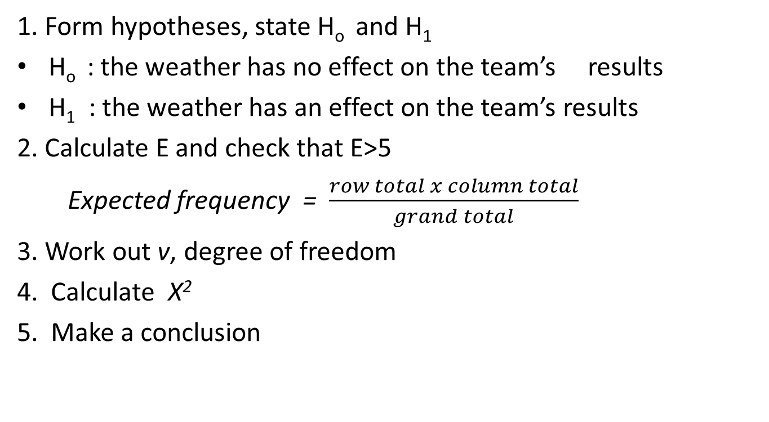
Example 12.8
1. Form hypotheses, state H_{o} and H₁
H_{o} : the weather has no effect on the team’s results
H₁ : the weather has an effect on the team’s results
2. Calculate E and check that E˃5
Expected frequency = $\frac{row total x column total}{grand total}$
3. Work out v, degree of freedom
4. Calculate X²
5. Make a conclusion

Slide 3
How to find v
V = (h-1) (k-1)

